Slide 1
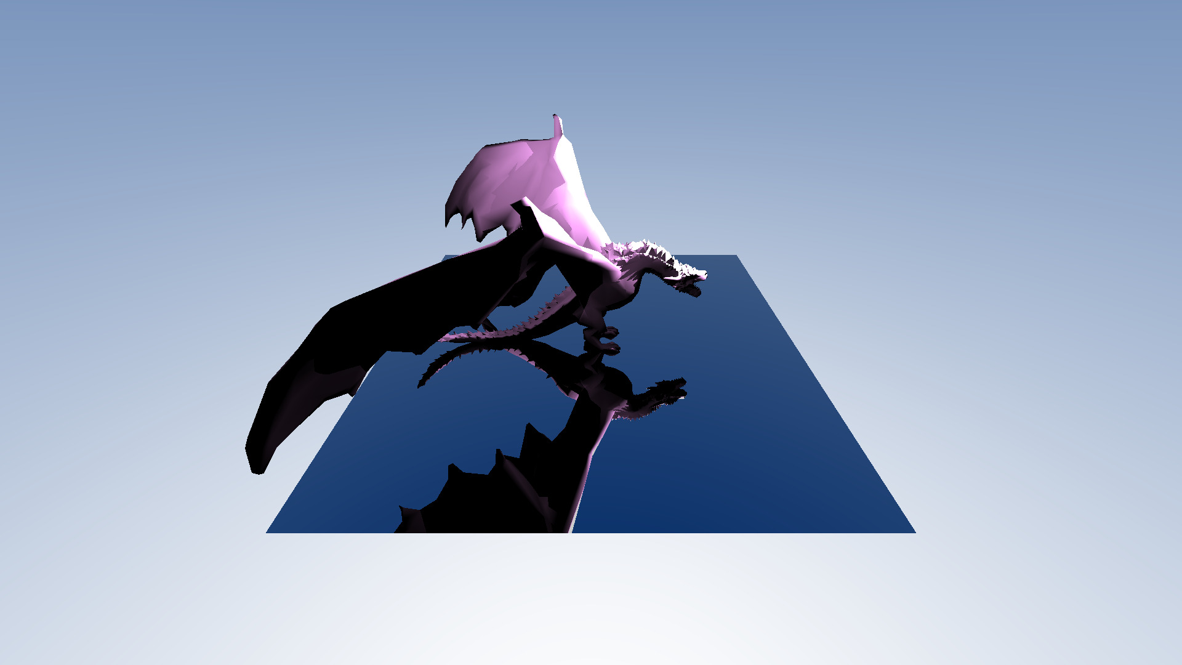
Chaos Camp 2026
Philip Lisichkov

Slide 2
What’s missing?
Image and procedural textures
Bounding Volume Hierarchy

Slide 3
Image Generation Process
Reading the scene

Slide 4
Image Generation Process
Reading the scene
Elements of the scene:
List of mesh
List of lights
List of materials
Camera
Renderer

Slide 5
Image Generation Process
Reading the scene
Building AABBs for each mesh

Slide 6
Image Generation Process
Reading the scene
Axis-aligned bounding box:
min. extent
max. extent
Building AABBs for each mesh

Slide 7
Image Generation Process
Reading the scene
Building AABBs for each mesh
Rendering the image
Writing the image

Slide 8
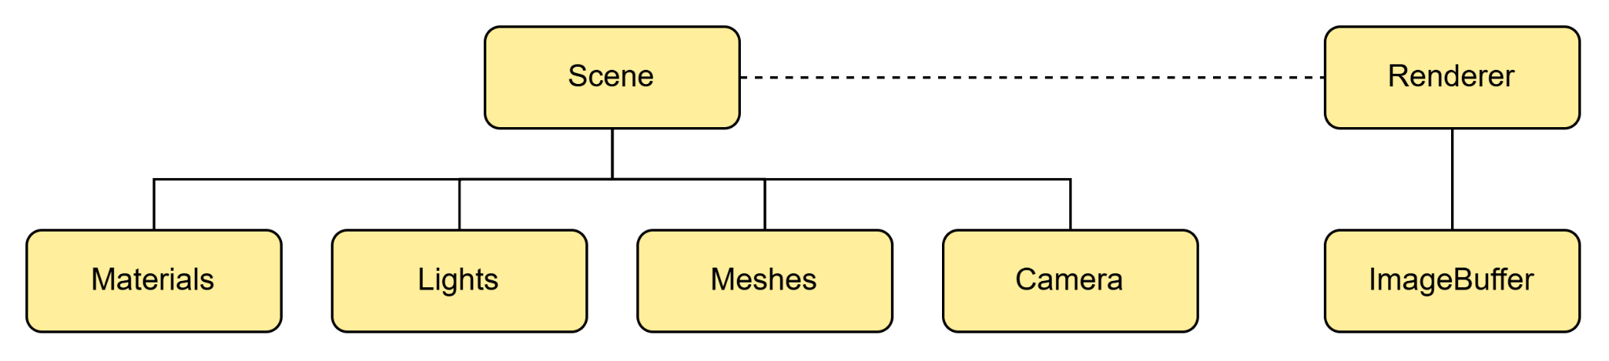
Project Structure

Slide 9
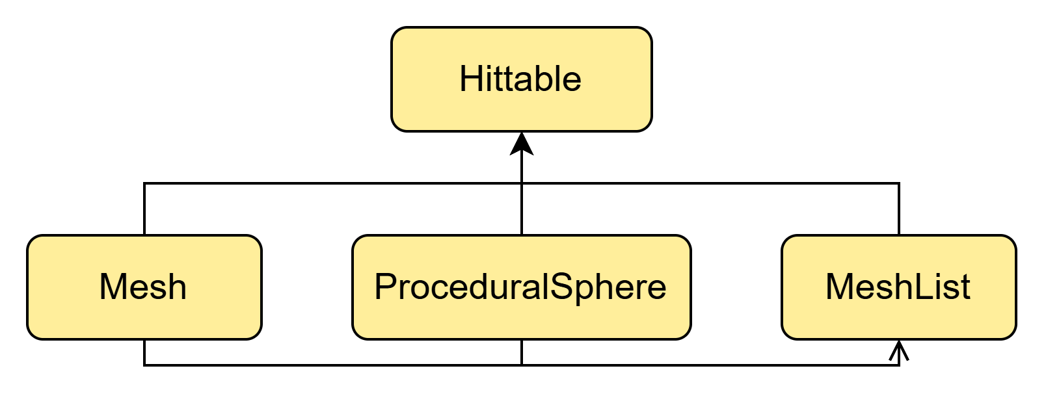
Project Structure

Slide 10
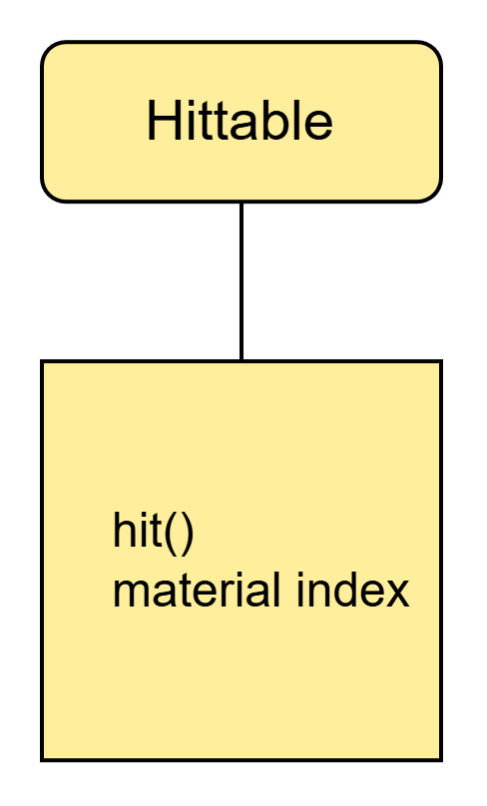
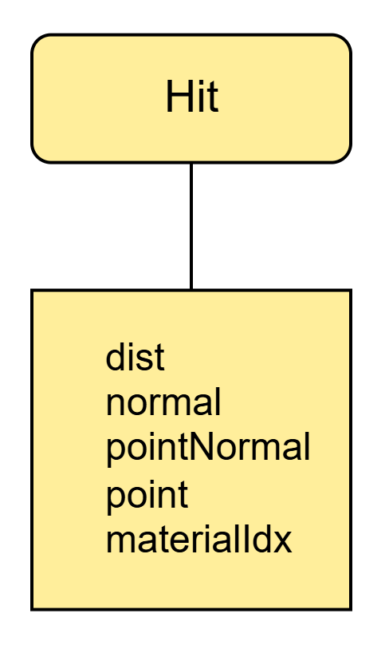
Project Structure

Slide 11
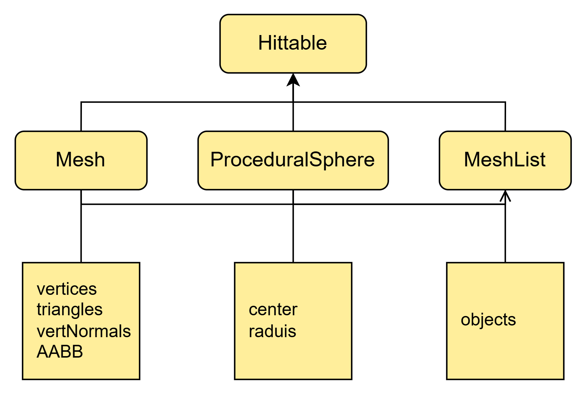
Project Structure

Slide 12
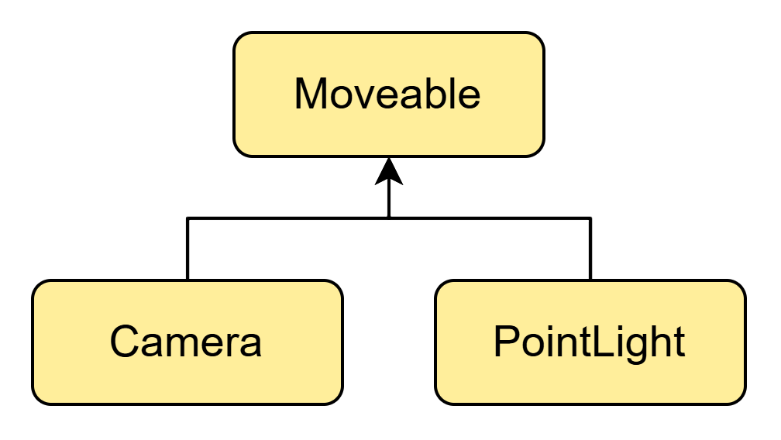
Project Structure

Slide 13
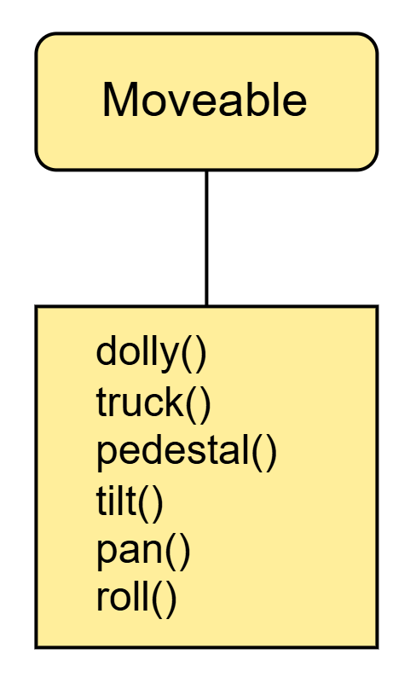
Project Structure

Slide 14
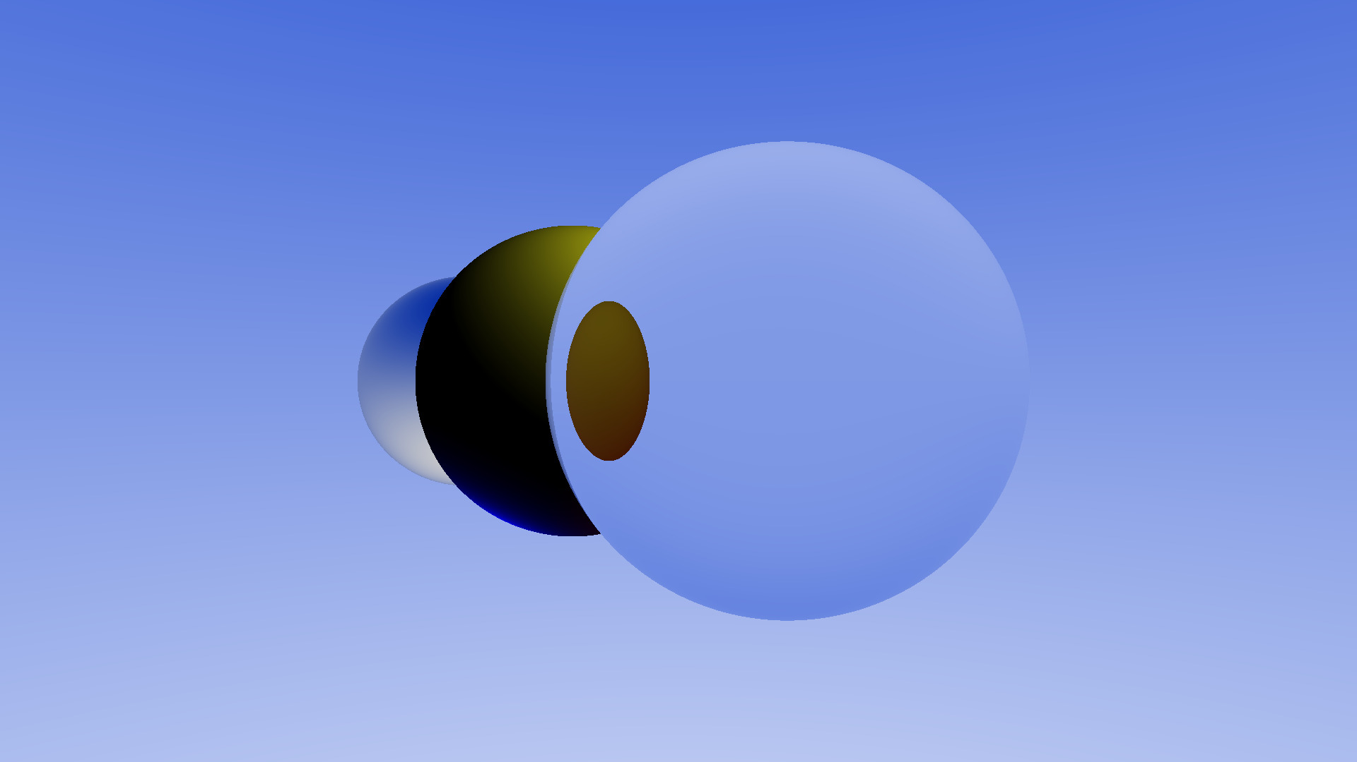
Rendering algorithm

Slide 15
Multithreaded Buckets Rendering Algorithm
Construct buckets
Assign buckets to threads until list is empty
For each thread
  Render region defined by bucket -> Write to image buffer
Join threads

Slide 16
Rendering Single Region
For each pixel
  Construct ray with the camera as the origin
  If the ray depth limit is reached, return black
  Else, calculate color depending on the material type

Slide 17
Rendering Diffuse Material
For each light source
  Calculate the light received: dot(hitNormal, normalized(lp))
    hitNormal - the normal of the surface
    lp - the reverse direction of the light ray
  Multiply by the albedo

Slide 18
Chaos Camp 2026
Philip Lisichkov

Slide 19
What’s missing?
Image and procedural textures
Bounding Volume Hierarchy

Slide 20
Image Generation Process
Reading the scene
Elements of the scene:
List of mesh
List of lights
List of materials
Camera
Renderer

Slide 21
Image Generation Process
Reading the scene
Axis-aligned bounding box:
min. extent
max. extent
Building AABBs for each mesh

Slide 22
Image Generation Process
Reading the scene
Building AABBs for each mesh
Rendering the image
Writing the image

Slide 23
Project Structure

Slide 24
Project Structure

Slide 25
Project Structure

Slide 26
Project Structure

Slide 27
Project Structure

Slide 28
Project Structure

Slide 29
Rendering algorithm

Slide 30
Multithreaded Buckets Rendering Algorithm
Construct buckets
Assign buckets to threads until list is empty
For each thread
  Render region defined by bucket -> Write to image buffer
Join threads

Slide 31
Rendering Single Region
For each pixel
  Construct ray with the camera as the origin
  If the ray depth limit is reached, return black
  Else, calculate color depending on the material type

Slide 32
Rendering Diffuse Material
For each light source
  Calculate the light received: dot(hitNormal, normalized(lp))
    hitNormal - the normal of the surface
    lp - the reverse direction of the light ray
  Multiply by the albedo

Slide 33
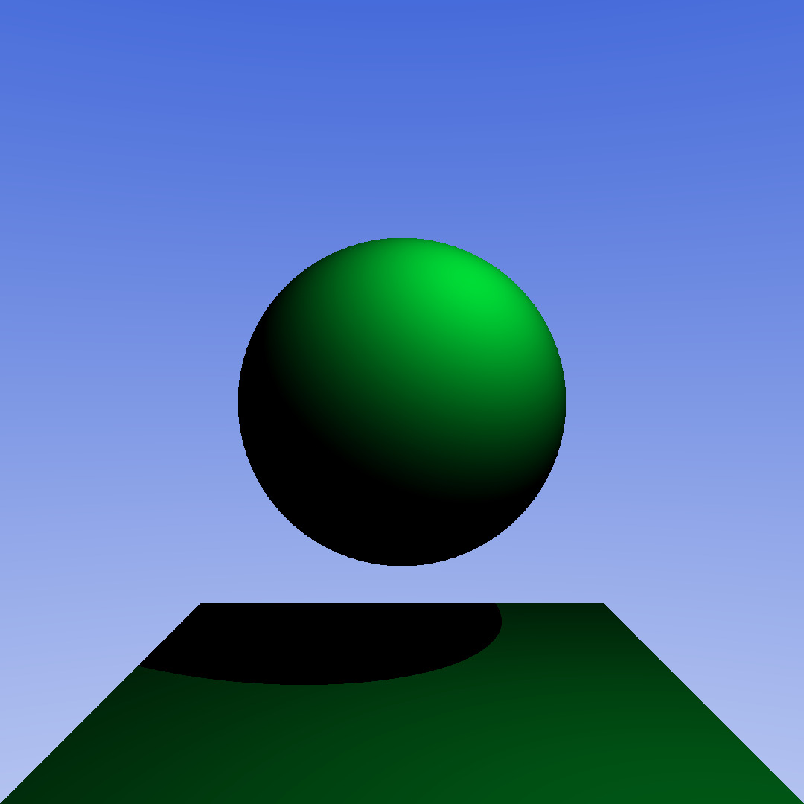
Rendering Diffuse Material
For each light source
  Calculate the light received: dot(hitNormal, normalized(lp))
    hitNormal - the normal of the surface
    lp - the reverse direction of the light ray
  Multiply by the albedo

Slide 34
Rendering Diffuse Material
For each light source
  Calculate the light received: dot(hitNormal, normalized(lp))
    hitNormal - the normal of the surface
    lp - the reverse direction of the light ray
  Multiply by the albedo

Slide 35
Rendering Reflective Material
Construct reflection vector through the ray vector and surface normal
  R = D - 2 * dot(R, N) * N
Multiply the resulting color with the material albedo

Slide 36
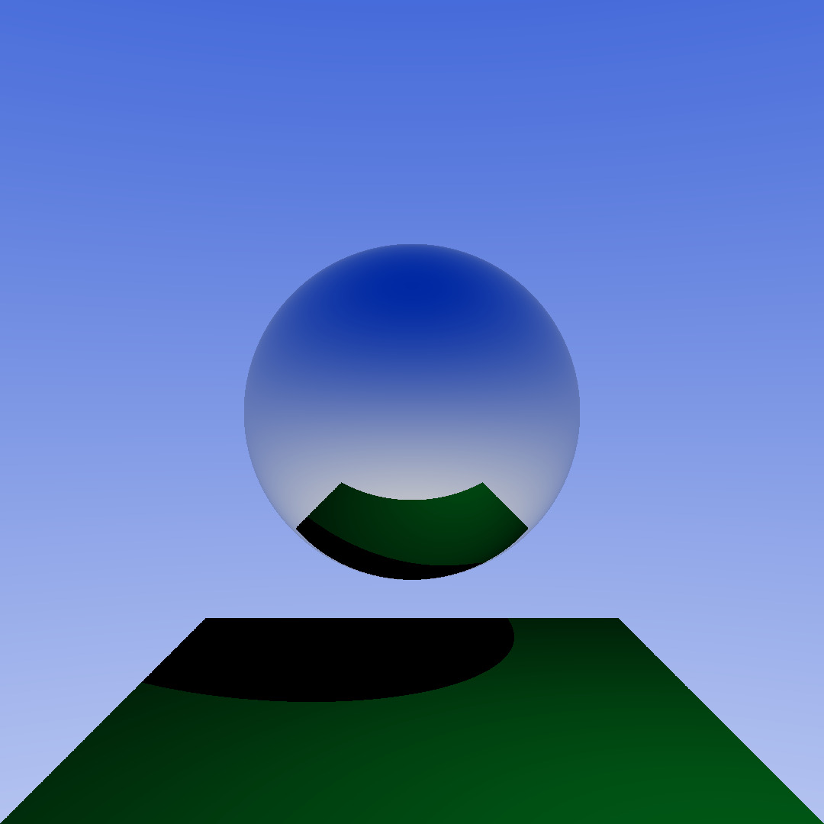
Rendering Reflective Material
Construct reflection vector through the ray vector and surface normal
  R = D - 2 * dot(R, N) * N
Multiply the resulting color with the material albedo

Slide 37
Rendering Refractive Material
Check if entering or leaving refractive material
  if leaving then swap IORs and flip hit normal & proceed
Check if angle between ray and normal is below the critical
  if yes then build refraction ray & reflection ray & trace them
  if not then build reflection ray & trace it

Slide 38
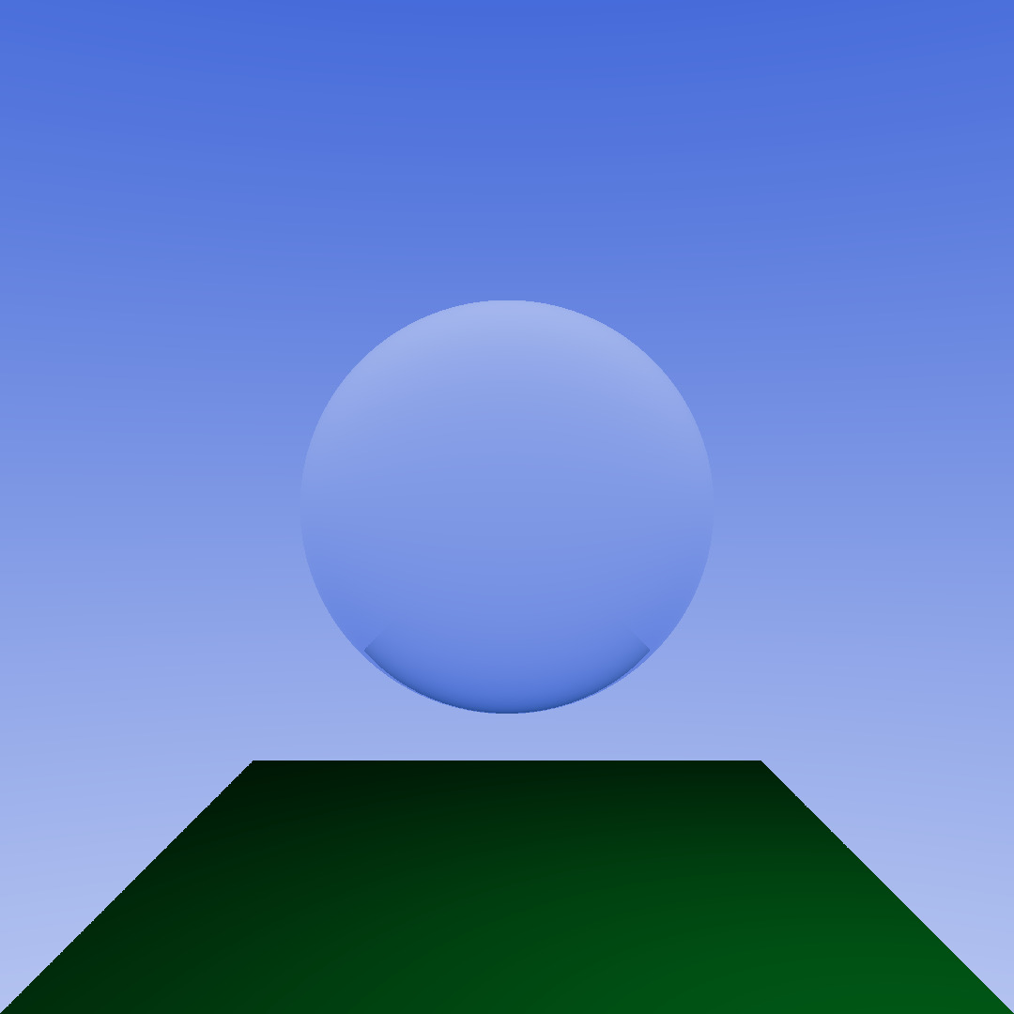
Rendering Refractive Material
Check if entering or leaving refractive material
  if leaving then swap IORs and flip hit normal & proceed
Check if angle between ray and normal is below the critical
  if yes then build refraction ray & reflection ray & trace them
  if not then build reflection ray & trace it
IOR = 1.5

Slide 39
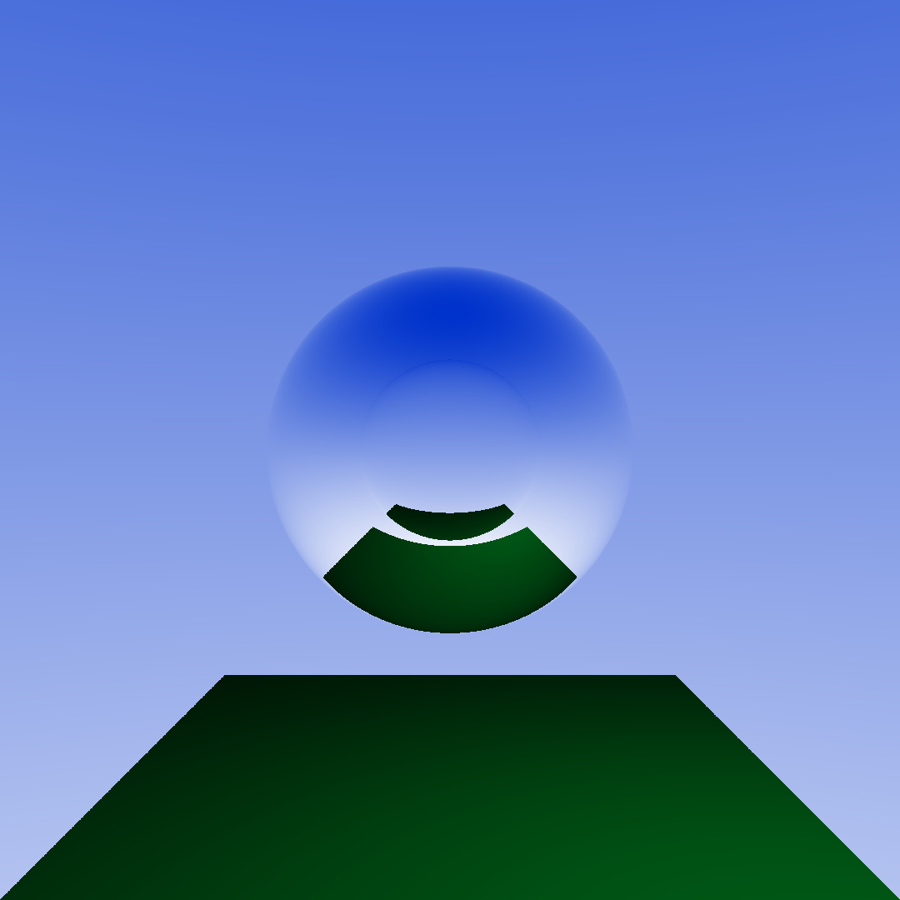
Rendering Refractive Material
Check if entering or leaving refractive material
  if leaving then swap IORs and flip hit normal & proceed
Check if angle between ray and normal is below the critical
  if yes then build refraction ray & reflection ray & trace them
  if not then build reflection ray & trace it
IOR = 1.5
IOR = 0.5

Slide 40
What will be added?
BHV for each mesh and for the scene
Textures
  Image, procedural, normal
Global Illumination
…

Slide 42
Q&A
Any questions? Ask away!

Slide 43
Thank you!

